Slide 1
COVID-19 TOTAL ANTIBODIES
(IgG & IgM, SERUM) Testing for Screening & Contact Tracing

Slide 2
Why Antibody Testing?
Clinical Utility of Antibody Testing:
This test measures the body’s immune response to COVID-19. Presence of antibodies indicate that one is likely infected with COVID-19 in the past. It covers both IgM & IgG Antibodies, which provides a higher bandwidth in terms of better sensitivity & exposure.
This test bridges the gap between RT PCR & IgG antibody Testing. It is used for mass screening programmes – Sero-surveillance & not for diagnosis.
ICMR recommends RT PCR as the gold standard test for COVID-19 diagnosis.
Does this test require any special preparation?
No. This test is a simple blood test. It does not require fasting, or any specific diet or even Doctor’s prescription. Only basic TRF & Form 45 shall be required to be filled by Lab Personnel
Why should one get Antibody Test done?
If you are healthy at present, but suspect contact with an infected person
If you do not have any symptoms, but you are certain of your exposure with infected person
If you are working in banks, post, courier, telecom offices, airlines, press, international operations or corporates
If you a frontline worker in healthcare, police & security services

Slide 3
Why Antibody Testing?
What is the difference between IgG Antibody Testing & Total Antibody Testing?
While Total antibody test gives a higher band width in terms of sensitivity & good exposure evidence, IgG testing is for immunity development & identifying plasma donors etc.
What is the meaning of test report?
The test quantifies antibodies – IgG & IgM which are good determinant of body’s immune response & reaction to SARS-CoV-2.
This test helps evaluate sero-prevalence in a given population & helps bridge the window of detection between a positive RT PCR & seroconversion to IgG.
Positive Result indicates Antibodies have developed, Exposure to SARS CoV-2 is confirmed. RT PCR is suggested to confirm diagnosis.
Negative result indicates Exposure not confirmed, Antibodies not developed
Test | Result | Interpretation | Action
Total Antibody (IgG+IgM*) | Positive | Antibodies have developed Exposure to SARS COV-2 is confirmed | Symptomatic - Refer to RT PCR
 |  |  | Asymptomatic - Quarantine & repeat IgG after 7-10 days
 | Negative | Exposure not confirmed, Abs not developed | Symptomatic refer to RT PCR
 |  |  | Asymptomatic - confirmed negative
When can I get my Report?
Sample daily by 11 am, then Report Next Day

Slide 4
Screening your Staff for Total Antibodies before Joining Work
Advantage for Corporates & Private Firms:
Total antibody test gives a higher band width in terms of sensitivity & good exposure evidence
No need of Doctors’ Prescription
Faster Turn-around Time
Cost Effective
Simple Blood Test
Easy Decision Making
We recommend WHO protocol during work & office
Thermal Screening
Sanitizing hands frequently
Wearing Mask

Slide 5
Test Details Of Sars Cov-2 (Covid-19) Total Antibodies
Method : SIEMENS ATELLICA CLIA
TAT : Sample Daily by 11 am; Report Next day
Price : ₹ 950

Slide 6
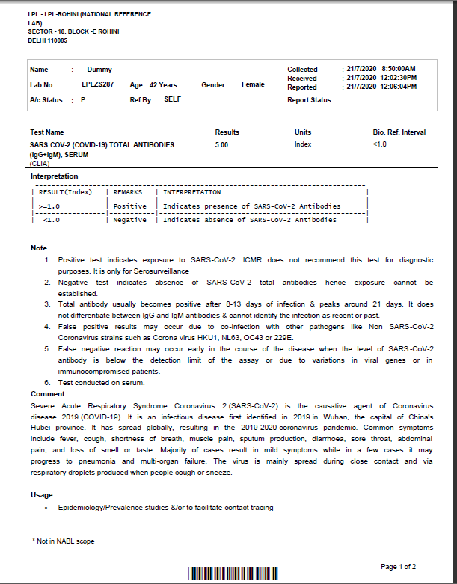
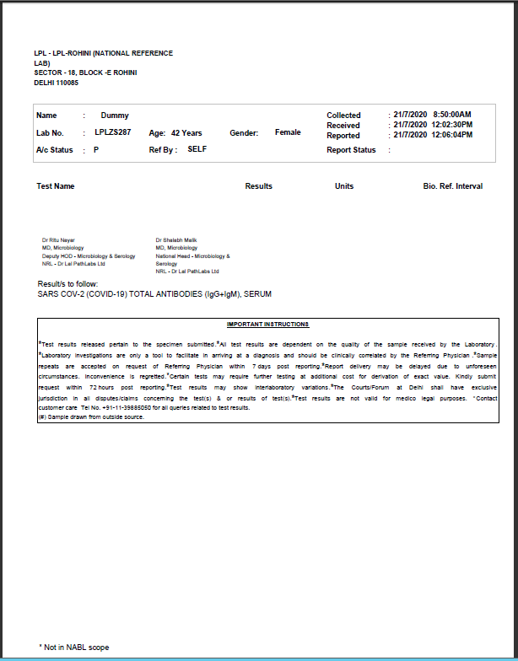
Sample Report

Slide 7
COVID – 19
IgG Antibody Testing for Recovery & Plasma Donors

Slide 8
Why IgG Antibody Testing?
Clinical Utility of Antibody Testing:
This test measures the body’s immune response to COVID-19. Presence of IgG antibodies indicate that one is on the recovery phase post COVID-19 infection, that the person has developed immunity against COVID-19. It is used for mass screening programmes – Sero-surveillance, finding plasma donors & not for diagnosis.
ICMR recommends RT PCR as the gold standard test for COVID-19 diagnosis.
Longevity of IgG antibodies is not known.
Does this test require any special preparation?
No. This test is a simple blood test. It does not require fasting, or any specific diet or even Doctor’s prescription. Only basic TRF & Form 45 shall be required to be filled by Lab Personnel
Why should one get IgG Antibody Test done?
As per ICMR, It should be opted by health care workers, frontline workers, immune-compromised individuals, individuals in containment zones, prisons, Police, Air travel staff etc. to know who has been infected in the past and has now recovered. The 17 groups have been highlighted in ICMR Press Release, 30th May

Slide 9
Why Antibody Testing?
What is the difference between IgG Antibody Testing & Total Antibody Testing?
While Total antibody test gives a higher band width in terms of sensitivity & good exposure evidence, IgG testing is for immunity development & identifying plasma donors etc.
What is the meaning of IgG test report?
This is a quantitative test for the detection of SARS-CoV-2 (COVID-19) IgG Antibodies
Positive test indicates exposure to SARS-CoV-2.
Negative test indicates absence of SARS-CoV-2 IgG antibodies hence immunity status cannot be established.
IgG antibody usually becomes positive after 8 - 13 days of infection & peaks around 21 days.
RESULT | INTERPRETATION
Positive | Indicates presence of SARS-CoV-2 IgG Antibodies
Negative | Indicates absence of SARS-CoV-2 IgG Antibodies
When can I get my Report?
Sample daily by 11 am, then Report Next Day

Slide 10
Test Details Of Sars Cov-2 (Covid-19) IgG Antibodies
Method : SIEMENS ATELLICA CLIA
TAT : Sample Daily by 11 am; Report Next day
Price : ₹ 1400

Slide 11
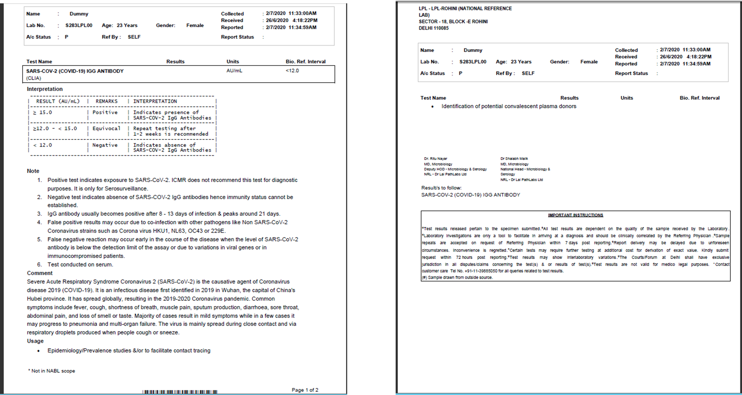
Sample Report

Slide 12
Thank You

